Slide 1

IBM Summer Internship TABLE PARTITION Name – Vinayak Vedant Srivastava Batch - 2

Slide 2
Big data
Big data is a term used to describe a collection of data that is huge in size and yet growing exponentially with time.
What is Hadoop?
The Apache Hadoop software library is a framework that is used for storing and processing big data.
Apache Hadoop is a collection of open-source software utilities that facilitate using a network of many computers to solve problems involving massive amounts of data and computation.

Slide 3
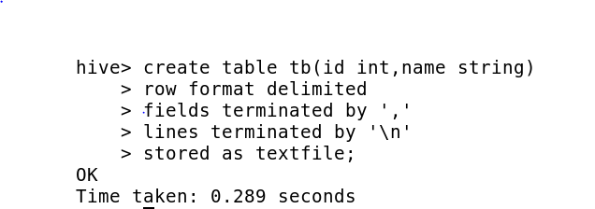
Hive
Hadoop offers various tools for processing data and Hive is one of them.
Hive is a data warehouse infrastructure tool to process structured data in Hadoop (used for structure and semi structured data analysis and processing).
Create a Table

Slide 4
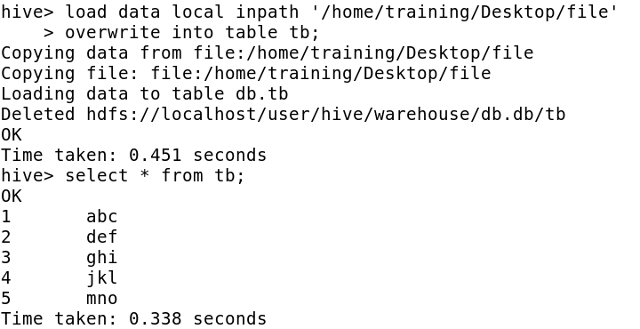
How to load data in a table?

Slide 5
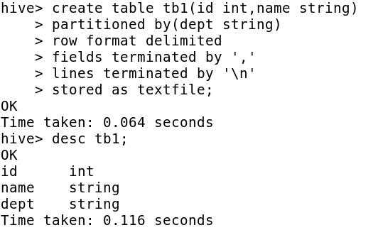
Create a PARTITION TABLE

Slide 6
HIVE PARTITIONING
Partitioning is the optimization technique in Hive which improves the performance significantly.
The value of partitioned column divide a table into segments
Types of Hive Partitioning
There are two types of Partitioning in Apache Hive-
Static Partitioning
Dynamic Partitioning

Slide 7
Static Partition
Insert input data files individually into a partition table is Static Partition.
Usually when loading files (big files) into Hive tables static partitions are preferred.
We can alter the partition in the static partition.
If you want to use the Static partition in the hive you should set property set hive.mapred.mode = strict This property set by default in hive-site.xml
Static partition is in Strict Mode.

Slide 8
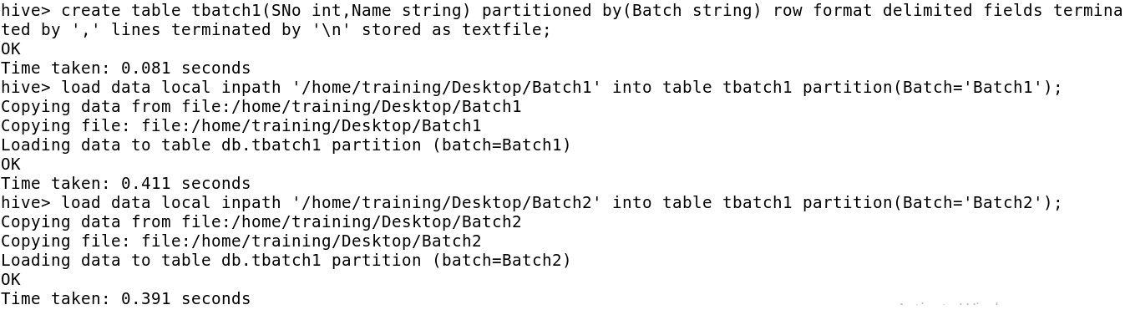
How to perform Static Partition

Slide 9
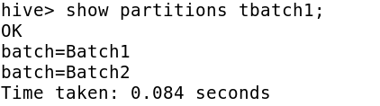
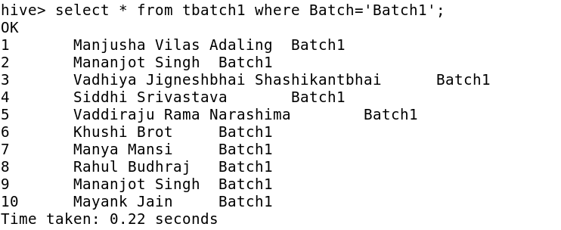
Partitions Performed Loaded Data

Slide 10
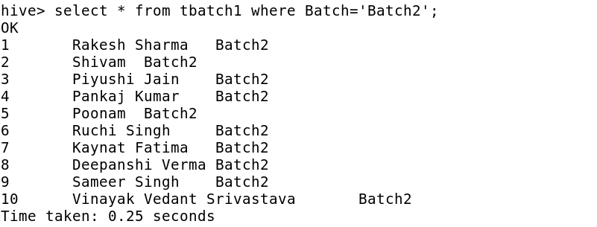
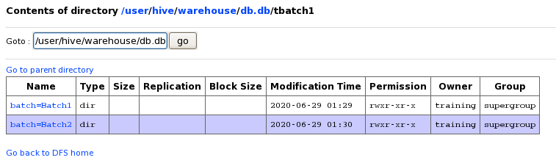
Partitions shown on Hadoop

Slide 11
Dynamic Partition
Single insert to partition table is known as a dynamic partition.
Usually, dynamic partition loads the data from the non-partitioned table.
Dynamic Partition takes more time in loading data compared to static partition.
If you want to use the Dynamic partition in the hive you should set property;
set hive.exec.dynamic.partition=true
set hive.exec.dynamic.partition.mode=nonstrict

Slide 12
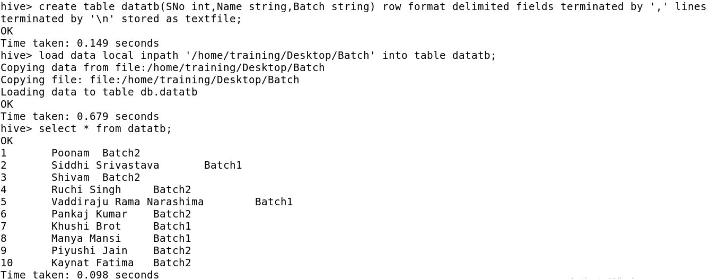
How to perform Dynamic Partition
Load data in a Non-Partitioned table

Slide 13
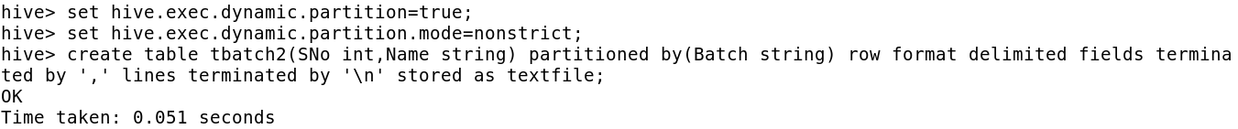
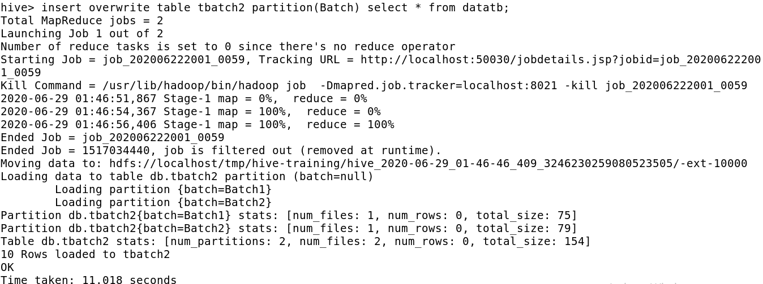
Create a Partition Table
Load data on the basis of Non-Partitioned Table

Slide 14
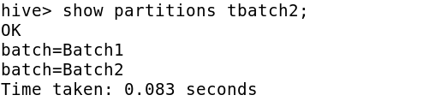
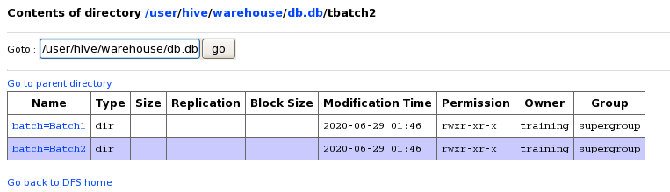
Partitions Performed
Partitions shown on Hadoop

Slide 15
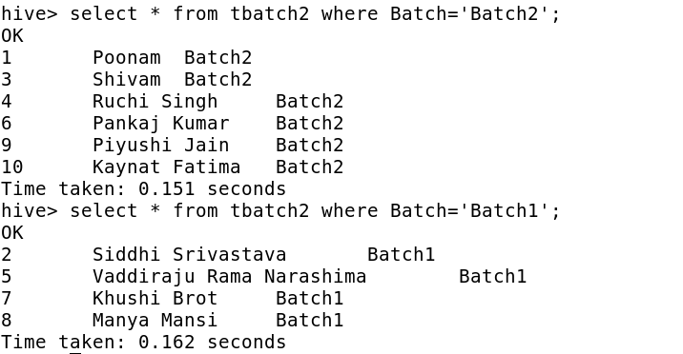
Loaded Data

Slide 16
Advantages and Disadvantages
Advantages:-
Partitioning in Hive distributes execution load horizontally.
In partition faster execution of queries with the low volume of data takes place.
Disadvantages:-
There is the possibility of too many small partition creations- too many directories.
Partition is effective for low volume data. But there some queries like group by on high volume of data take a long time to execute.
There is no need for searching entire table column for a single record.

Slide 17
☺ Thank You ☺ End Of Slide

